Slide 1
III-SEMESTER, II B.Sc.
EUKARYOTI C CELL.
DR. B.Diana J. Satya Latha, lecturer in Zoology, GCW(A), On duty basis, Guntur.

Slide 2
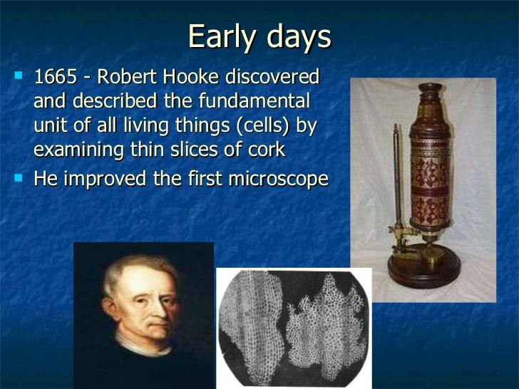

Slide 3
Eukaryotic Cell Definition
Eukaryotic cells are cells that contain a nucleus and organelles, and are enclosed by a plasma membrane.
Organisms that have eukaryotic cells include protozoa, fungi, plants
and animals.
These organisms are grouped into the biological domain Eukaryota. Eukaryotic cells are larger and more complex than prokaryotic cells,
which are found in Archaea and Bacteria, the other two domains of
life.

Slide 4
Characteristics of Eukaryotic Cells
Eukaryotic cells contain a variety of structures called organelles, which perform various functions within the cell.
Examples of organelles are ribosomes, which make proteins, the endoplasmic reticulum, which sorts and packages the proteins, and mitochondria, which produce the energy molecule adenosine tri-phosphate (ATP).

Slide 5
They also have a true nucleus, which contains the genetic material
DNA and is surrounded by a nuclear envelope.
All of the organelles are stabilized and given physical support through the cytoskeleton, which is also involved in sending signals from one part of the cell to the other.
In eukaryotic cells, the cytoskeleton is composed mainly of three types of filaments: microtubules, microfilaments, and intermediate filaments.
The gel-like substance that surrounds all the organelles in the cell is
called cytosol.

Slide 6
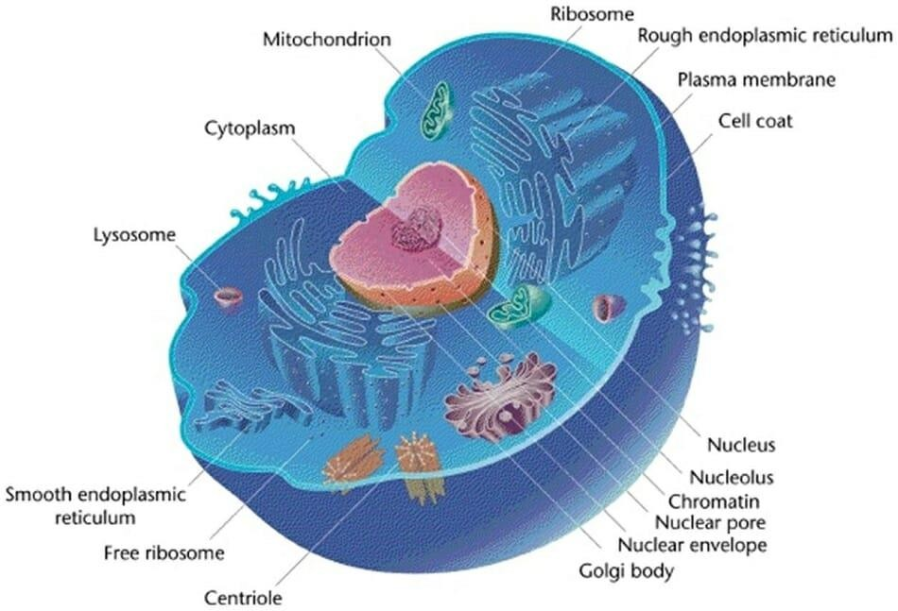

Slide 7
Plasma Membrane
The plasma membrane (cell membrane) is the organelle that
encapsulates the contents of the cell.
Apart from encapsulating cell contents, the plasma membrane also plays a vital role in regulating the movement of substances in and out of the cell.
As such, it is actively involved in such both passive and active transportation to and from the cell.

Slide 8
These processes also help maintain balance even when
conditions outside the cell change.
The plasma membrane is made up of two layers of phospholipids (phospholipids bilayer).

Slide 9
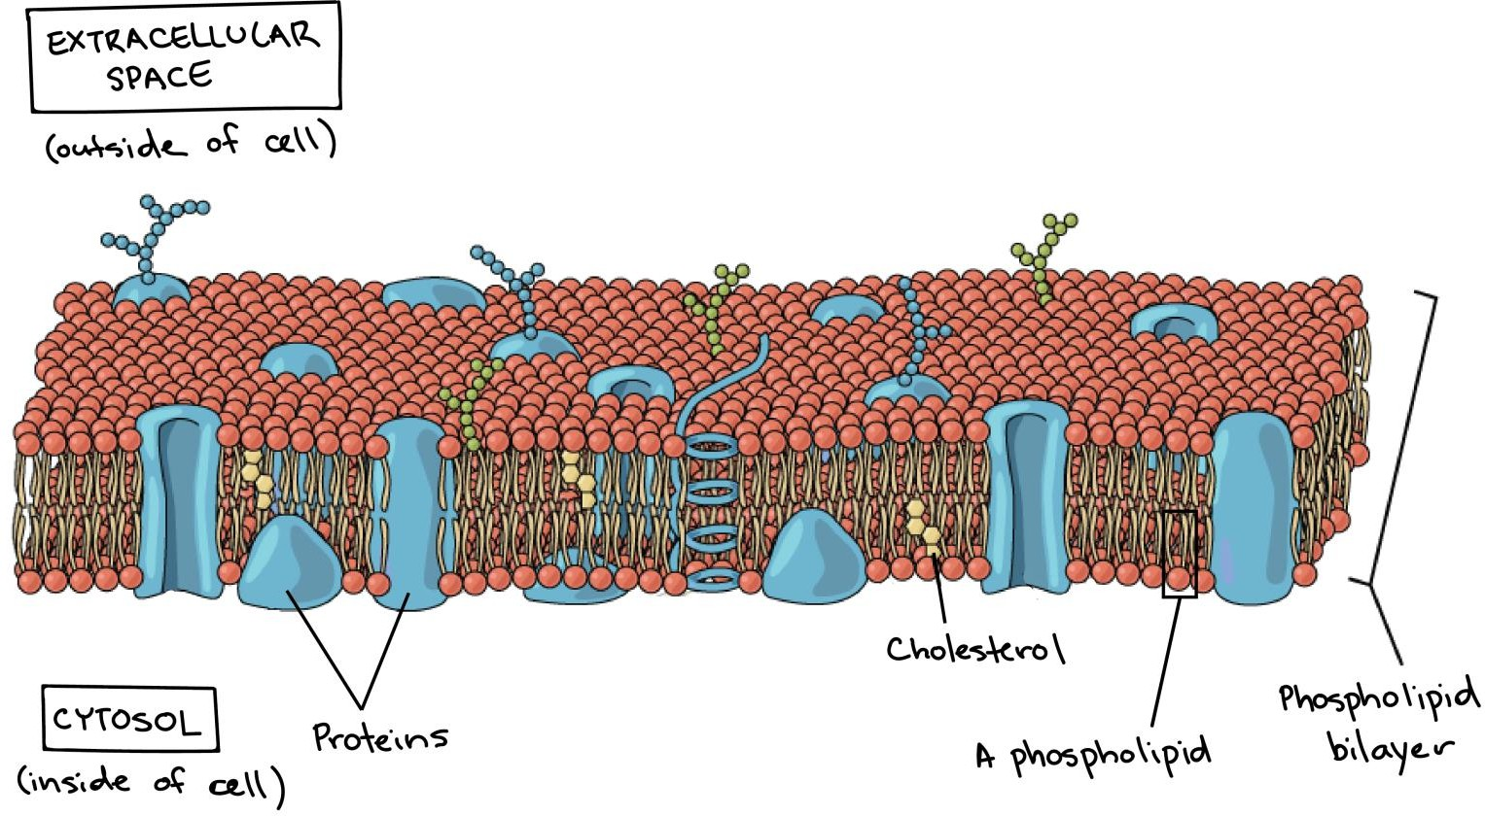

Slide 10
Nucleus/DNA
Some of the main components of the nucleus include the
chromatic, nucleoplasm/nuclear sap and the nucleolus.
The nucleus houses DNA (the hereditary material) as well as
various proteins and the nucleolus.
In eukaryotic cells, the nucleus is enclosed in a nuclear membrane.

Slide 11
It is the organelle that controls the hereditary traits of an organism by directing such processes as protein synthesis and cell division among others.
For prokaryotes, the DNA lacks a nuclear membrane. The genetic material is therefore bound in the nucleotide region.
* The nucleolus plays an important role in ribosome production.

Slide 12
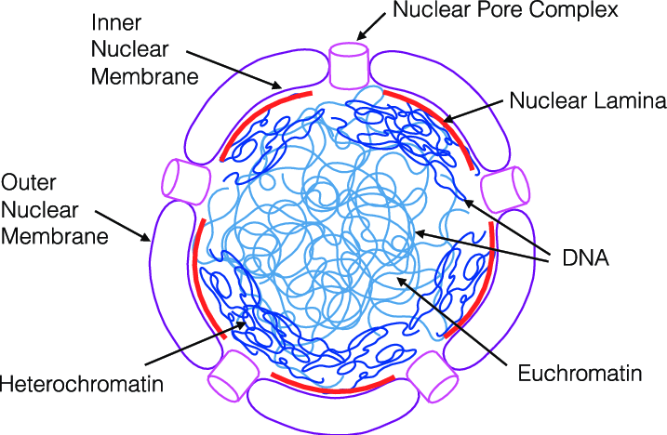

Slide 13
Ribosome
Ribosomes are tiny organelles that contain RNA and specific proteins within the cytoplasm.
Within the cell, ribosomes are directly involved in the manufacture of proteins by using their RNA and amino acids.
This process involves decoding the information contained in the mRNA and using amino acids to produce the required proteins.

Slide 14
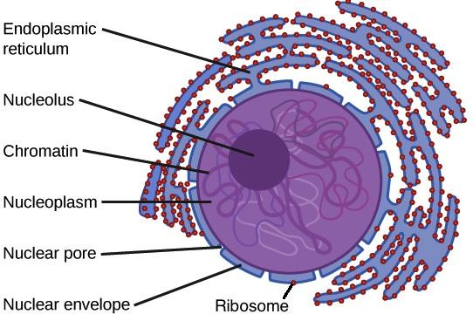

Slide 15
Mitochondria
Mitochondria are some of the largest organelles within a cell.
Compared to some of the other organelles, mitochondria contain DNA which makes them semiautonomous.
Mitochondria also contain a double-membrane with the inner
membrane folding to form cristae.
Also known as the powerhouse, mitochondria play an important role in respiration where they generate ATP (adenosine triphosphate) from substrates in the presence of oxygen.
Using their DNA, mitochondria are able to encode for some of
the components they require to perform their functions.

Slide 16
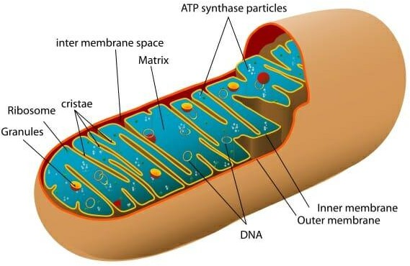
ATP stores energy in the form of chemical bonds and is released whenever it is needed for various cell functions.

Slide 17
Cytoskeleton
The cytoskeleton is made up of microtubules and microfilaments. By spreading throughout the cell (in the cytoplasm), the cytoskeleton helps maintain the shape of the cell while also ensuring its elasticity.
* The cytoskeleton is also involved in anchoring the nucleus and supporting cell contents.

Slide 18
Endoplasmic Reticulum
Found in eukaryotic cells, Endoplasmic reticulum (ER) is the organelle that forms an interconnected network of flattened sacs (cisternae).
Like some of the other organelles found in eukaryotes, ER is enclosed in a membrane.
The ER is divided into two regions that vary in structure and function.
These include:

Slide 19
Smooth endoplasmic reticulum
The smooth ER is named so because it lacks a ribosome on its surface. As a result, it is more smooth in appearance as compared to the rough ER. It is involved in the synthesis of lipids (e.g. phospholipids) and carbohydrates that are used to build the cell membrane.
Some of the other functions of the smooth ER include:
Transportation of vesicles
Enzyme production in the liver
Contraction of muscle cells in the muscles
Synthesis of hormones in the brain cells

Slide 20
Rough endoplasmic reticulum
Unlike the smooth ER, rough ER has ribosome attached to its surface.
It is involved in the manufacture of various proteins in the cell.
On the other hand, the rough ER is involved in the production of antibodies, insulin as well as transportation of proteins into the smooth ER.

Slide 21
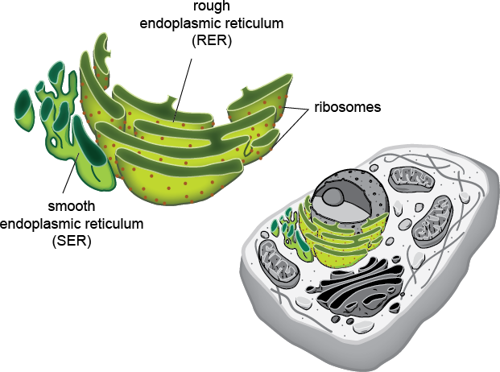

Slide 22
Centriole
Centrioles are cylindrical organelles found in most eukaryotic cells.
They contain tube-shaped molecules known as microtubules that help separate chromosomes and move them during cell division.

Slide 23
Lysosome
A lysosome is commonly referred to as sacs of enzymes.
They are membranous organelles that contain acidic enzymes (hydrolase enzymes) that serve to digest various macromolecules (e.g. lipids and nucleic acids) in the cell.
Conditions inside lysosomes have been shown to be acidic.
These conditions are maintained by the lysosome membrane thus providing favorable conditions for the enzymes to perform their functions.

Slide 24
Golgi Apparatus
Golgi apparatus are found in eukaryotic and are highly folded into cisternae (flattened sacs).
They are enclosed in a membrane that varies in thickness from different regions.
In the cell, Golgi apparatus are actively involved in the manufacturing, storage as well as transportation of products from the ER.

Slide 25
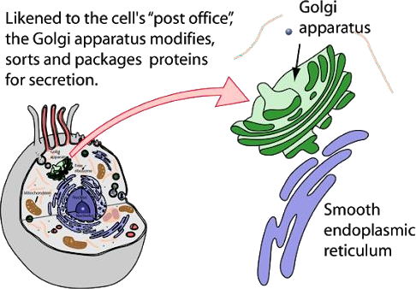

Slide 26
Cytoplasm
It is also not considered as an organelle in some books.
However, it is an important component of the cell.
Cell cytoplasm is composed of protoplasm in which all the
other cell organelles are suspended.
Many of the cell processes (protein synthesis, respiration etc)
take place in the cytoplasm.
The cytoplasm also plays an important role in the movement of various materials around the cell.

Slide 27
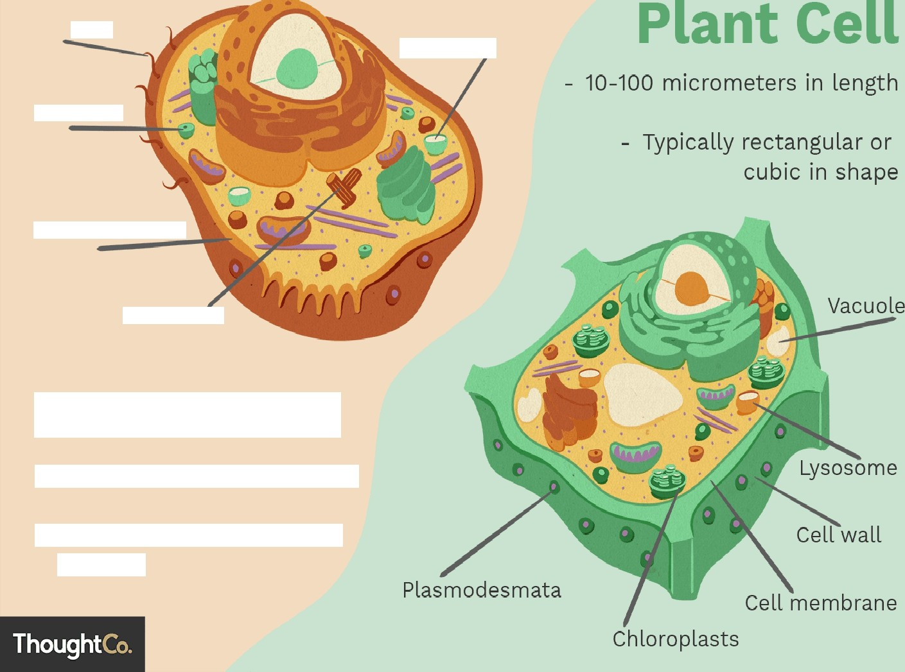
Cilia
Lysosomș:
Vacuoles
Cell membrane
Centriolès
Animal Cell
10-30 mïcrometers in length
Typically round or irregular in shape

Slide 28
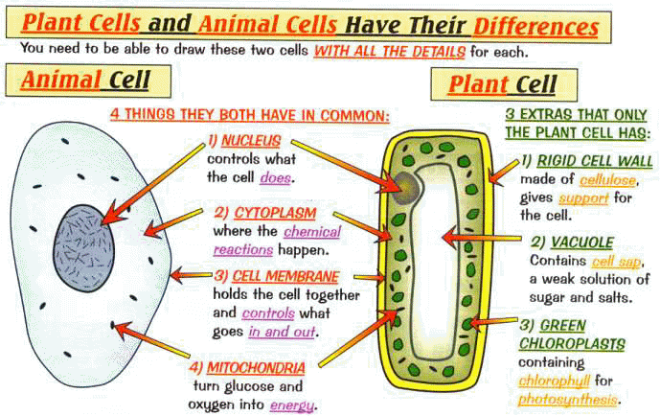

Slide 29
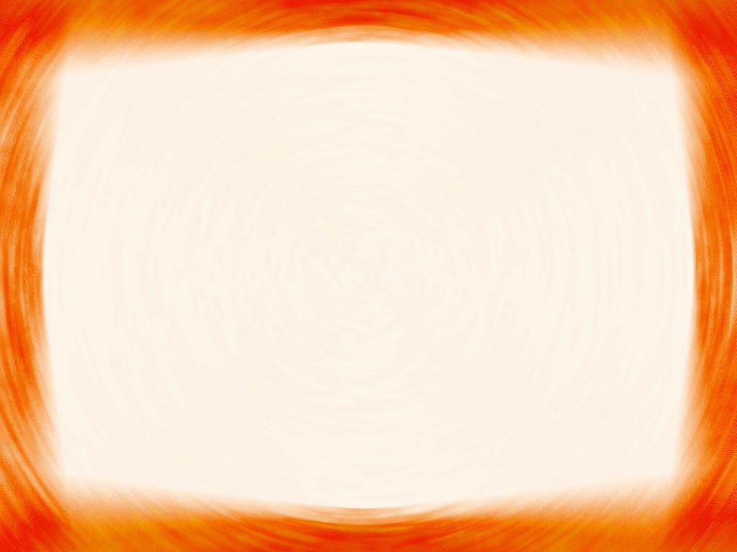
THANK YOU.

